Slide 1
Final Project-Group 20
Members:
Yuqi Yan 513452, Ziqi Yang 510320, Siyu Zhang 510266

Slide 2
Contents
Data Description & Data Sources
Dashboards Analysis
Story Interpretation
Recommendations

Slide 3
Data Description & Data Sources

Slide 4
Data Description & Data Sources
Data Description
Theme: Global Missing Migrants Dataset – Understanding Missing Migrants and Their Tragic Journeys
Description: This dataset provides a comprehensive record of missing migrants and their tragic journeys towards international destinations , collected by the Missing Migrants Project, an initiative implemented by the International Organization for Migration (IOM) since 2014. The dataset documents deaths and disappearances, shedding light on the challenges migrants face during their journeys. Please note that due to the complexities of data collection, the figures presented are likely an undercount. The dataset serves as a tribute to the individuals who lost their lives, as well as the families and communities impacted by their absence.
Data Sources
https://www.kaggle.com/datasets/nelgiriyewithana/global-missing-migrants-dataset

Slide 5
Dashboard Analysis

Slide 6
Dashboard 1
Analysis of:
Total number of deaths and disappearances related to the year
Minimum Estimated Number of Missing
Number of Dead
Number of Survivors

Slide 7
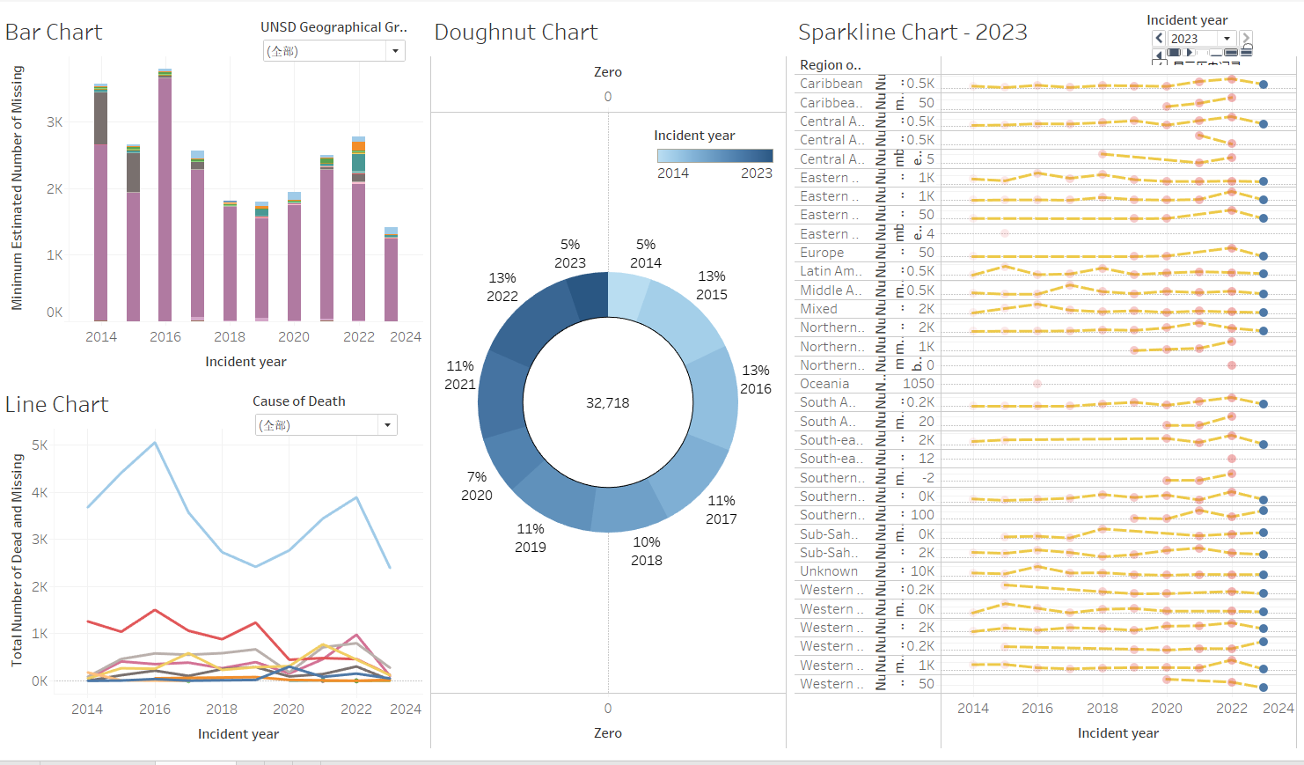
Dashboard 1
Three filters for cause of death, region, and chart type.
One Parameter for selecting chart.
By selecting the type of cause of death and the region you want to see through the filters, you can automatically display the information you need and automatically filter out other information.
PS: Our file has two Dashboards 1. The first Dashboard 1 does not have worksheet filtering and the second Dashboard 1 (also known as Dashboard 4) can filter different charts based on filters.

Slide 8
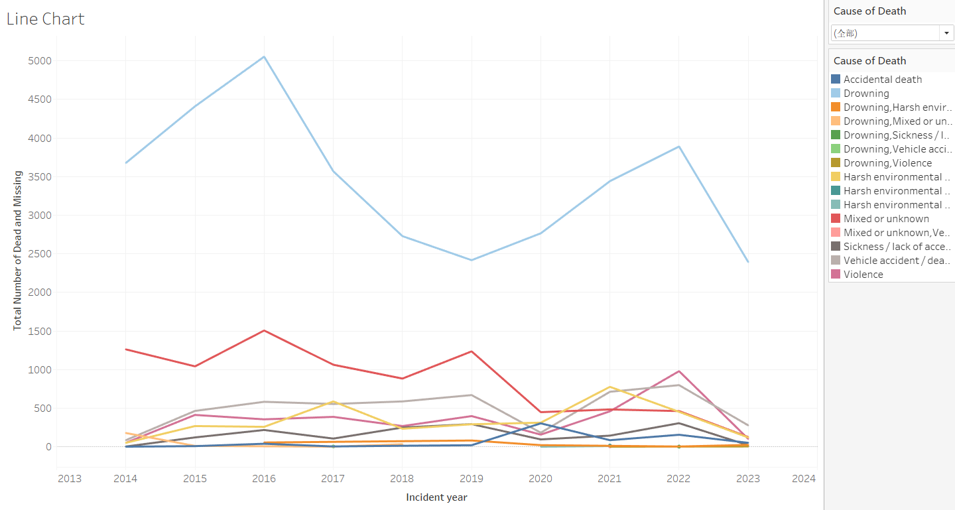
Total number of deaths and disappearances related to the year
This chart is a line chart of the total number of missing and dead people according to the year and cause of death.
According to the chart we can see that the most frequent cause of death and missing people in any year is drowning. In 2016 this number was even as high as 5,053, much higher than any other cause of death. Although in general the total number of missing and dead has been decreasing year by year, reaching a minimum of 4,301 in 2020, from 2020 the total number of dead and missing starts to rise again, reaching 7,062 in 2022 from 4,301. According to speculation it might be the Covid-19 epidemic that caused the number of deaths from all causes to gradually start rising. And in 2023, with the end of the epidemic, the figure began to decline more sharply again, from 7,062 to 3,134.

Slide 9
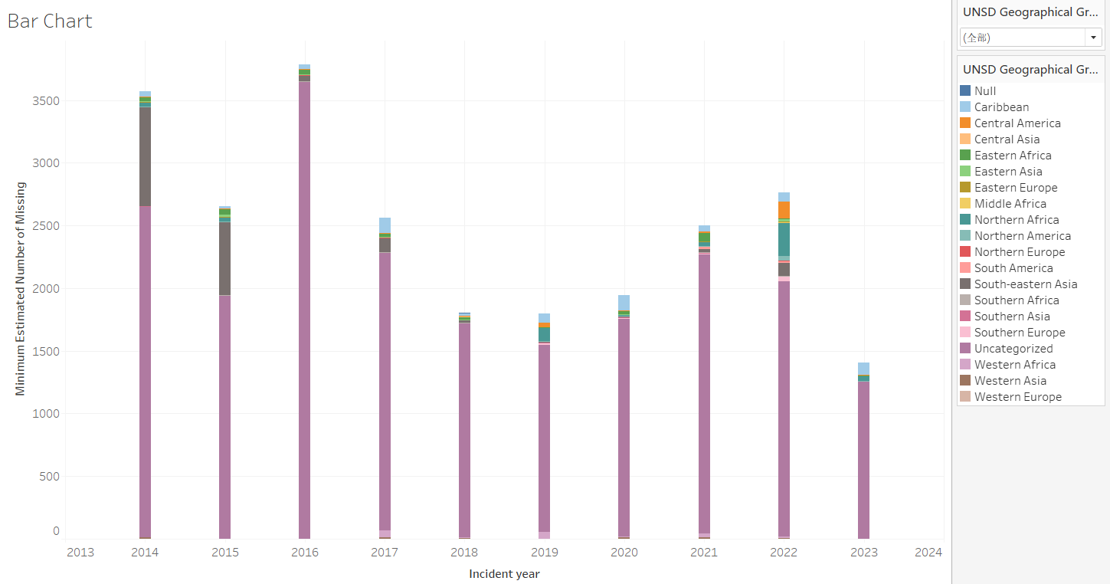
Minimum estimated number of missing in relation to year and region
This chart is based on the UNSD Geographical Grouping and the year of the bar chart on the minimum estimated number of missing, which can be clearly distinguished from the estimated number of missing persons by giving different colors to the different regions.
Regardless of the year, a large number of uncategorized people are estimated to be missing. The highest number remains in 2016, with a high estimate of 3,653 people. In addition to this, the highest estimates of the number of people predicted to go missing are for people in South-eastern Asia. But this figure is decreasing year by year, from 798 in 2014 to 102 in 2022, with the lowest value being 5 in 2019. The estimate of the number of missing people in the region as a whole has also been decreasing over the years, from 3,568 in 2014 to 1,409 in 2023. While midway through the year this figure rises in 2016, 2021 and 2022, the overall figure shows a downward trend.

Slide 10
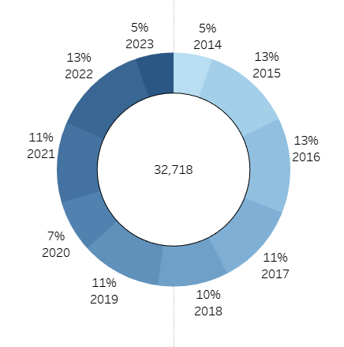
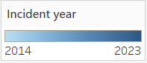
Relationship between number of dead and year
The chart is a donut chart related to Number of Dead made based on the year.
The chart shows that the total number of deaths from 2014 to 2023 is 32,718. The years 2015, 2016 and 2022 have the highest percentage of deaths at 13%. While 2014 and 2023 have the least share of deaths with only 5%.

Slide 11
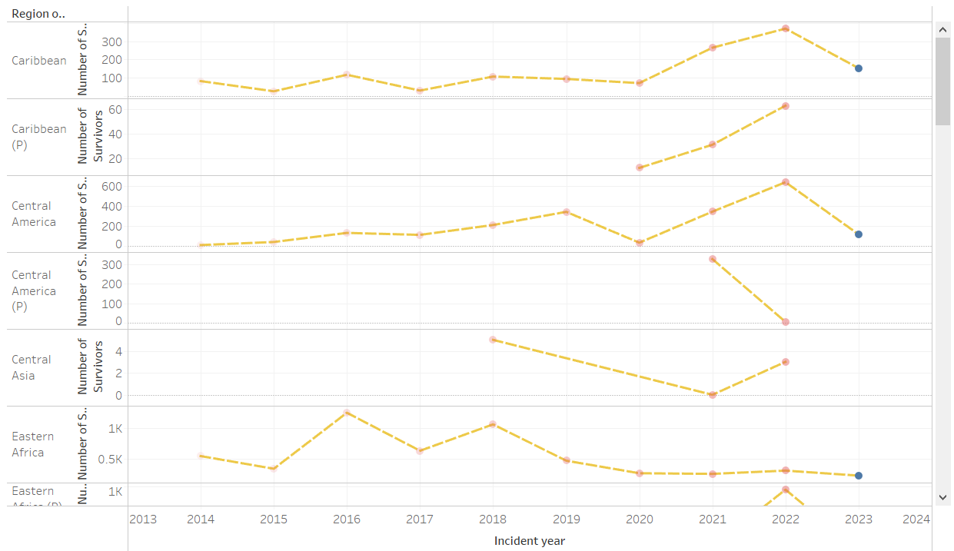
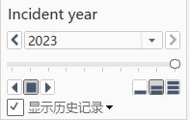
Number of survivors in relation to year
The chart is based on the number of survivors based on the year and the geographical region where the migrants originated.
By pulling the filters you can show the trajectory of the number of survivors per year. Then, by distinguishing the geographical region where the migrants originated, it is possible to deduce which region shows an upward trend in the number of survivors. In general, the number of survivors in all regions shows a relatively stable trend. In 2016 and 2022 there is a significant increase compared to the previous year, with the number of survivors in 2016 rising to 17,112 from 8,100 in 2015, and the number of survivors in 2022 rising to 12,771 from 9,765 in 2021. In all other years the number of survivors stayed around 6,000, fluctuating no more than 2,500. The regions where the number of survivors has been on the rise are Northern Africa (P), South America (P), Western Africa (P), Southern Africa, and the Caribbean (P).

Slide 12
Dashboard 2
Analysis of:
Region of Survivors and Dead Ratio
Top 9 Dead by Region
Top 9 Survivors by Region
Number of Children, Males, Females, and Sum in each Year
Percentage of Dead Along Migration Rout in each year

Slide 13
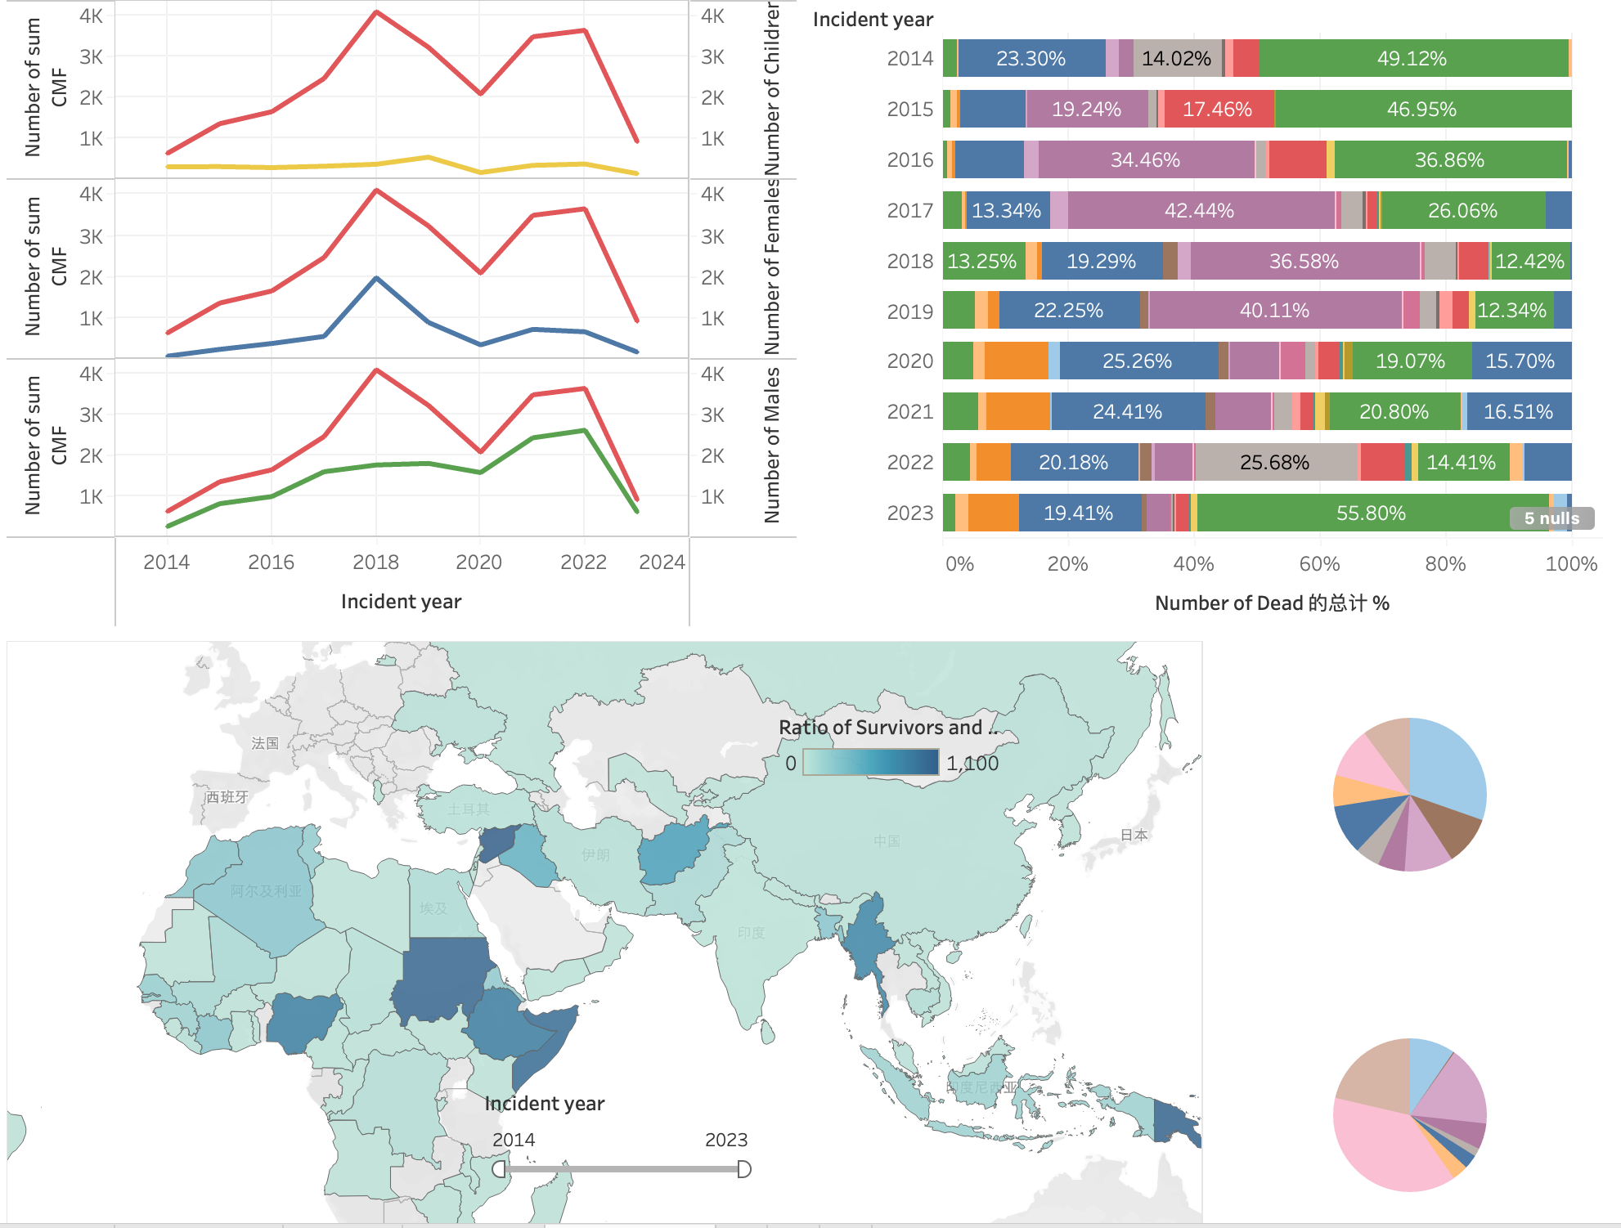
Dashboard 2
Three Filter and Two Highlight are created.
Clicking above two charts, the graphs will highlight by year. And clicking below three graphs, the graphs will highlight by region.
Chilcking below three graphs, all of other graphs will be filtered.

Slide 14
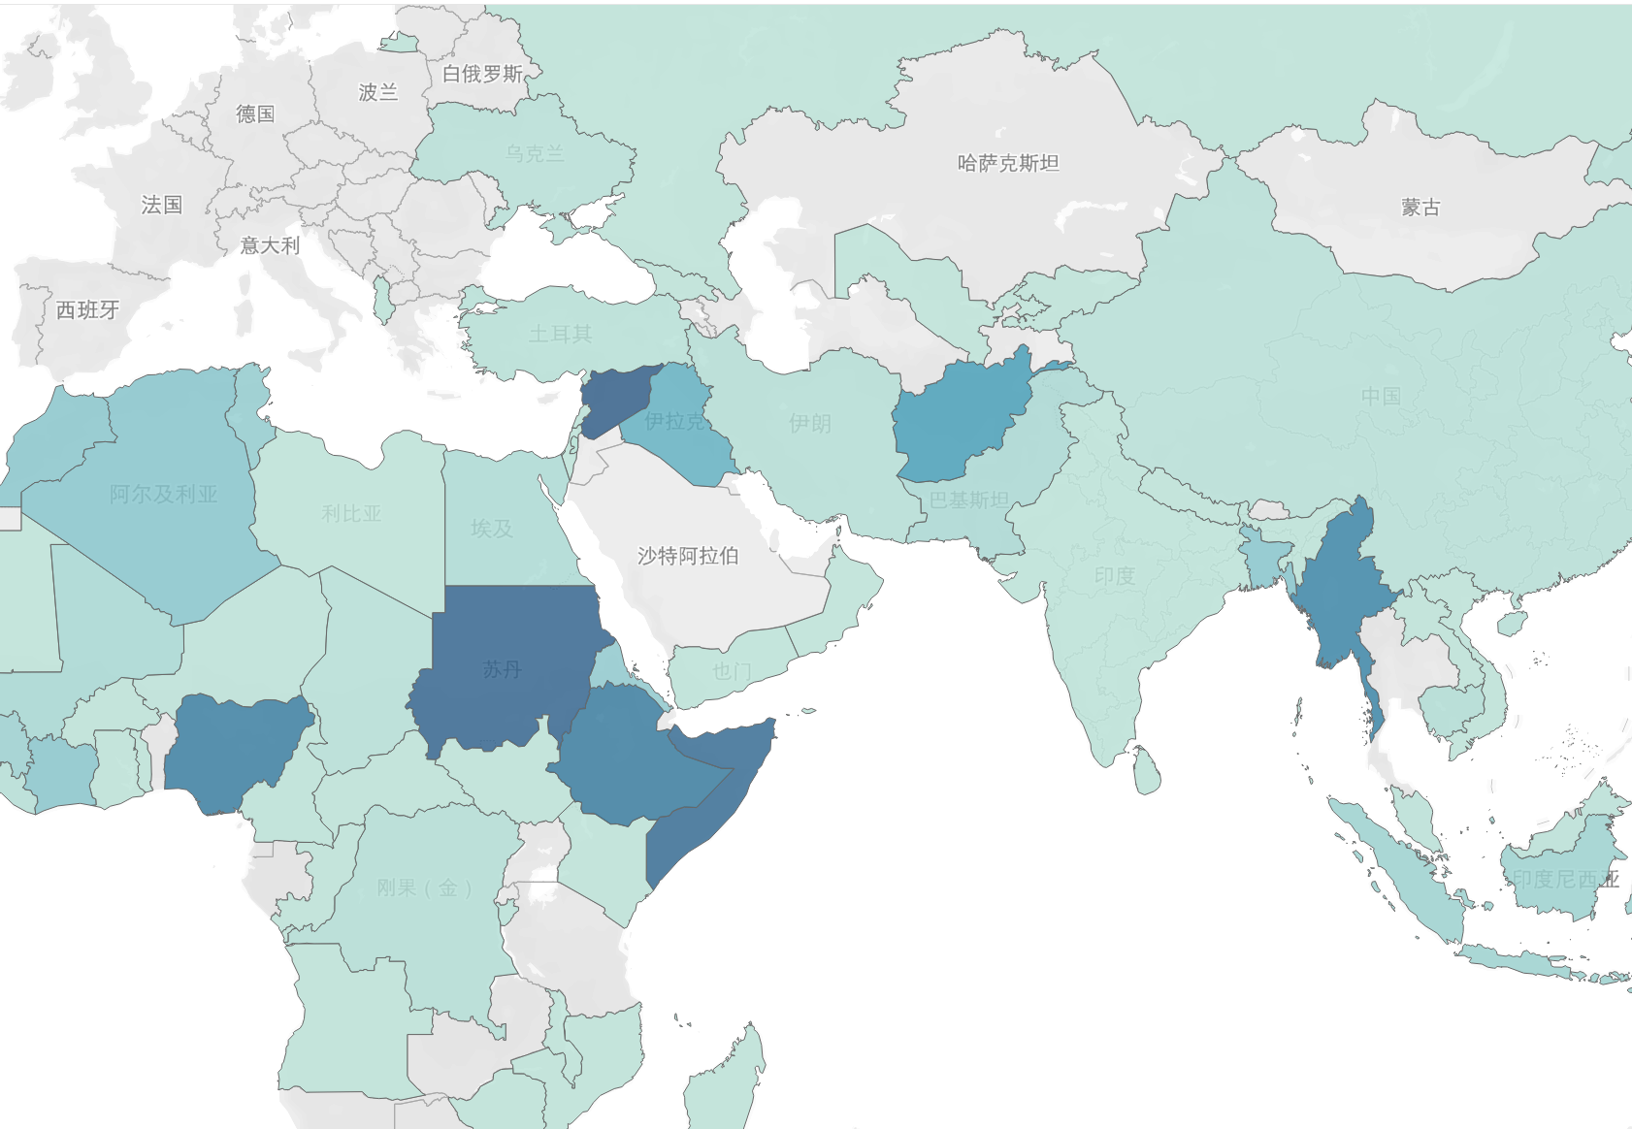
Region of Survivors and Dead Ratio
By using the created calculator “Ratio of Survivors and Dead”, the map shows survivors / dead ratio, the shades on the map indicate the size of this ratio, with bluer representing larger.
The bluest in the map is Syrian Arab Republic, then are Pupua New Guinia, Sudan, etc..

Slide 15
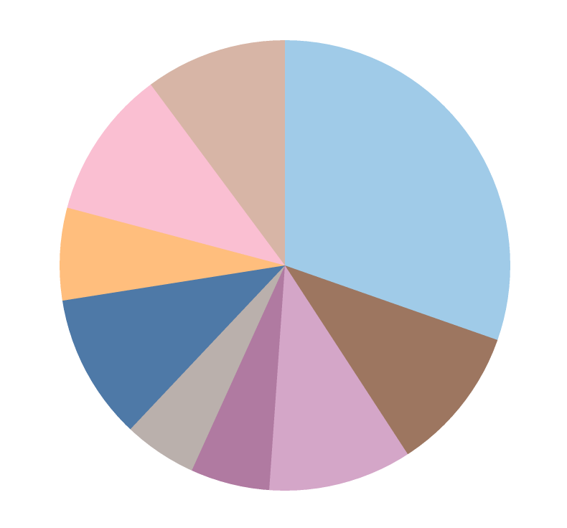
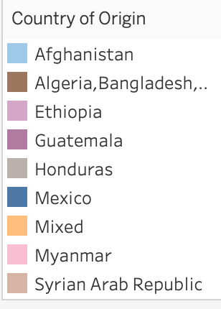
Top 9 Dead by Region
Using the 'Top 10' parameter, we can identify the 9 regions (Exclude null) with the highest number of deaths.

Slide 16
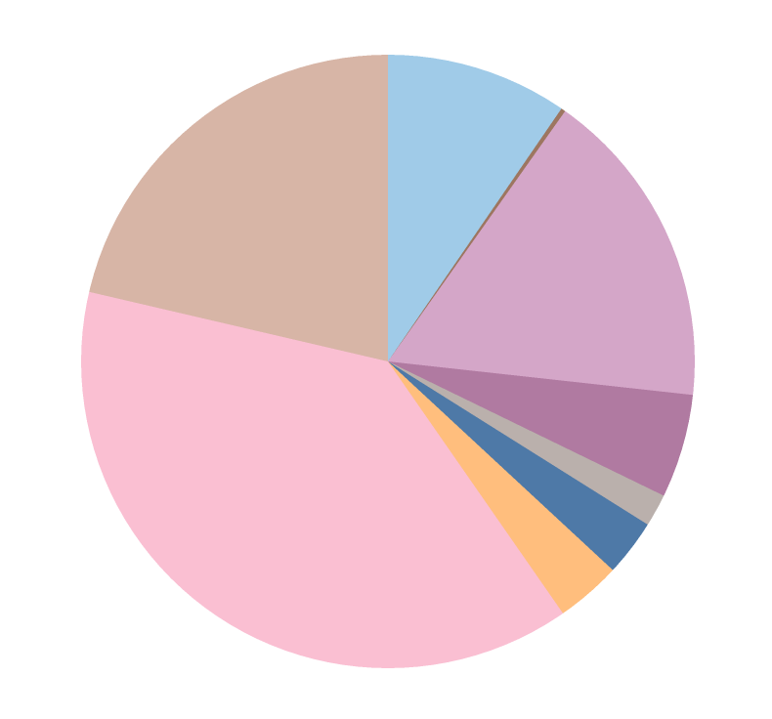
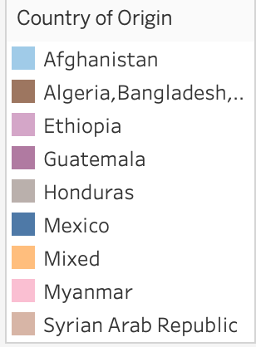
Top 9 Survivors by Region
Using the 'Top 10' parameter, we can identify the 9 regions (Exclude null) with the highest number of survivors.

Slide 17
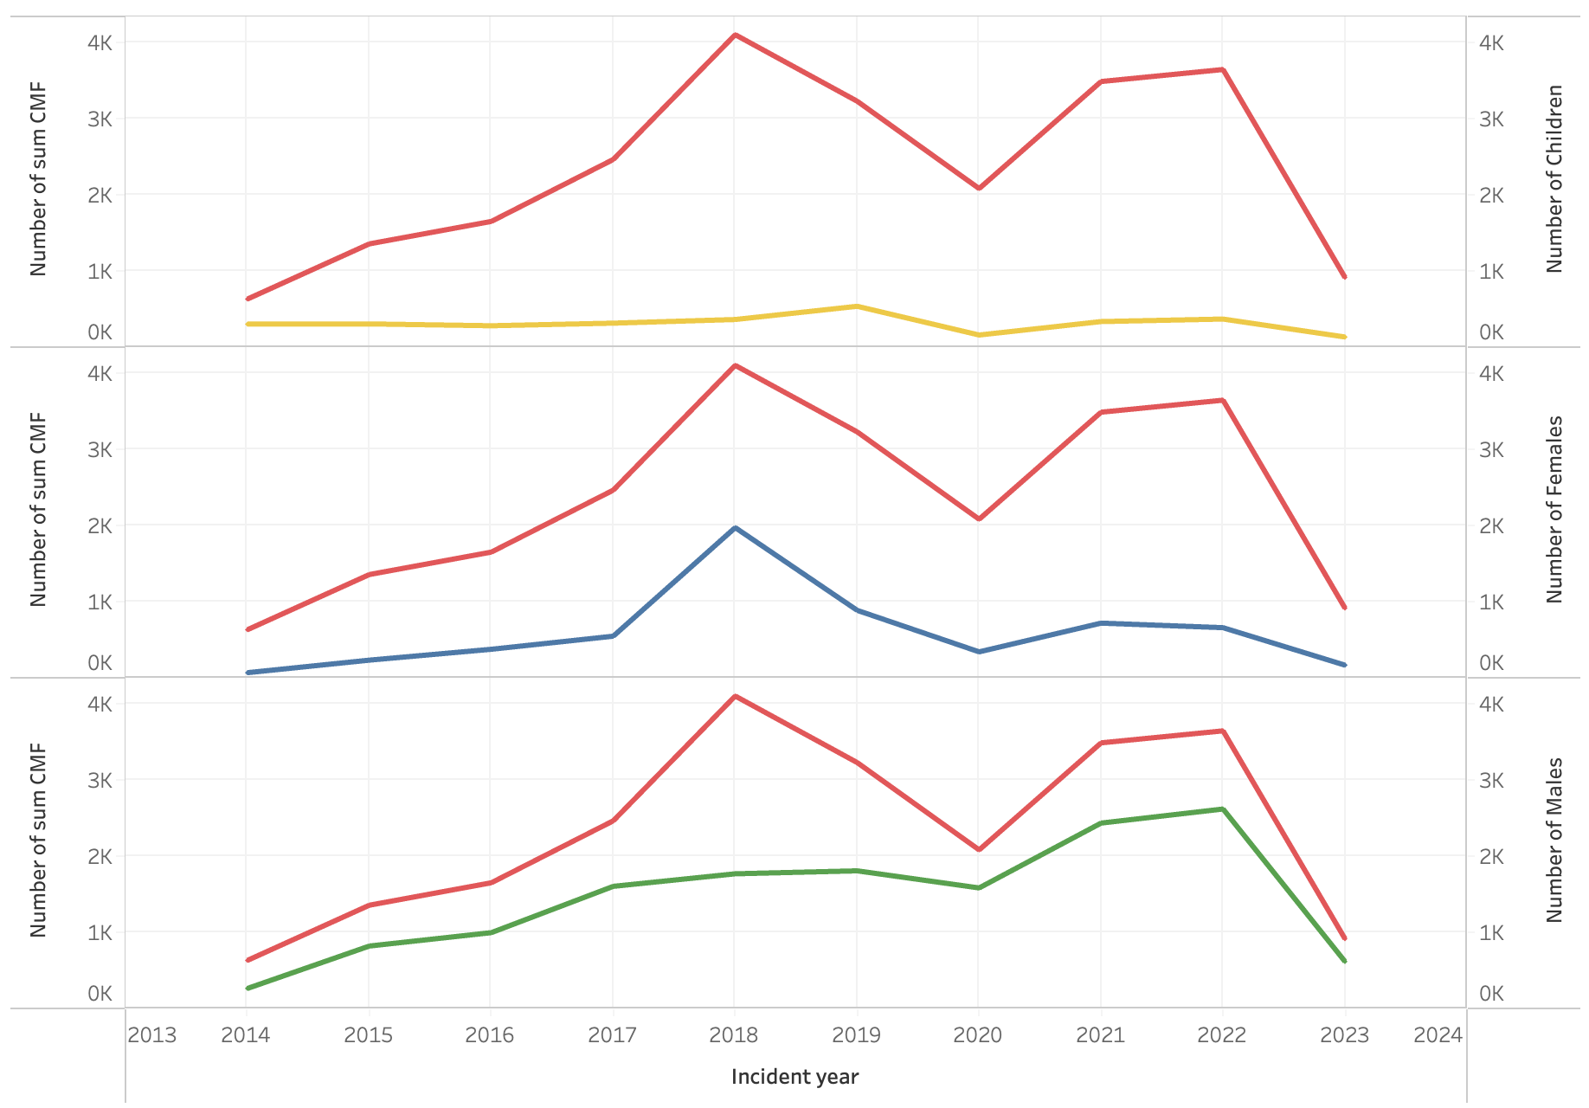
Number of Children, Males, Females, and Sum in each Year
By using the created calculator “Number of sum CMF” (Number of Children + Number of Females + Number of Males).
This graph shows the trends in the number of children and the overall number of children, the number of men and the overall number of men, and the number of women and the overall number of women, respectively, for each year from 2014 through 2023. We can see from the graph that the number of children has almost no effect on the overall, the number of men has a larger effect on the overall in 2014-2017 and 2020-2023, and the number of women has a larger effect on the overall in 2017-2020.

Slide 18
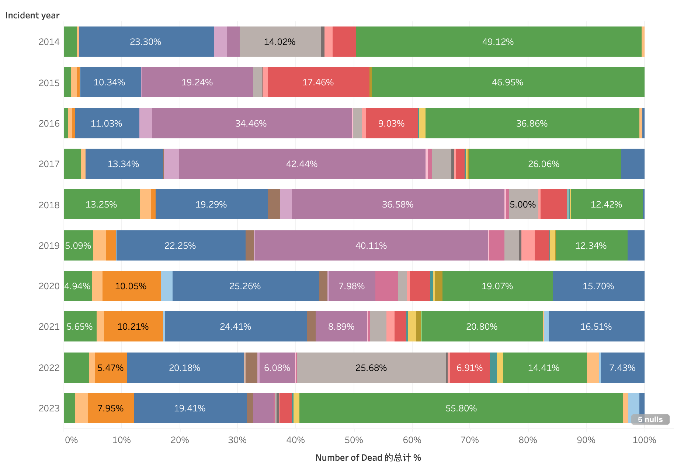
Percentage of Dead Along Migration Rout in each year
This graph shows the percentage of deaths for different migration routes from 2014-2023
The routes with larger proportions are US-Mexico border crossing, Sahara Desert crossing, and Central Mediterranean.

Slide 19
Dashboard 3
Analysis of:
Cause of Death
Migration Route
Origin vs Incident
Region of Incident

Slide 20
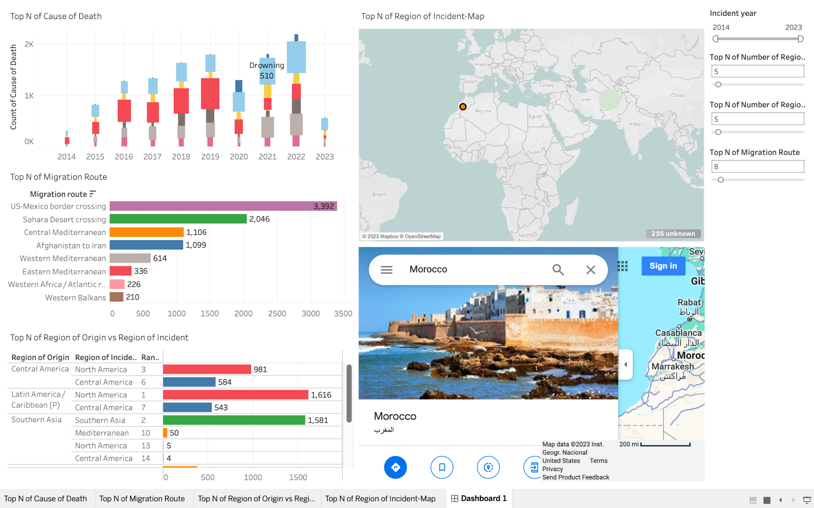
Dashboard 3
One Filter:
Incident Year, as selecting different year ranges, the left three sheets will change.
Three Parameters:
Top N of Migration Route
Top N of Number of Region of Incident
Top N of Number of Region of Origin
One Dashboard Action:
Hyperlink, as clicking circles on the map in the Top N of Region of Incident Map, the web page will show its locations on Google Map.

Slide 21
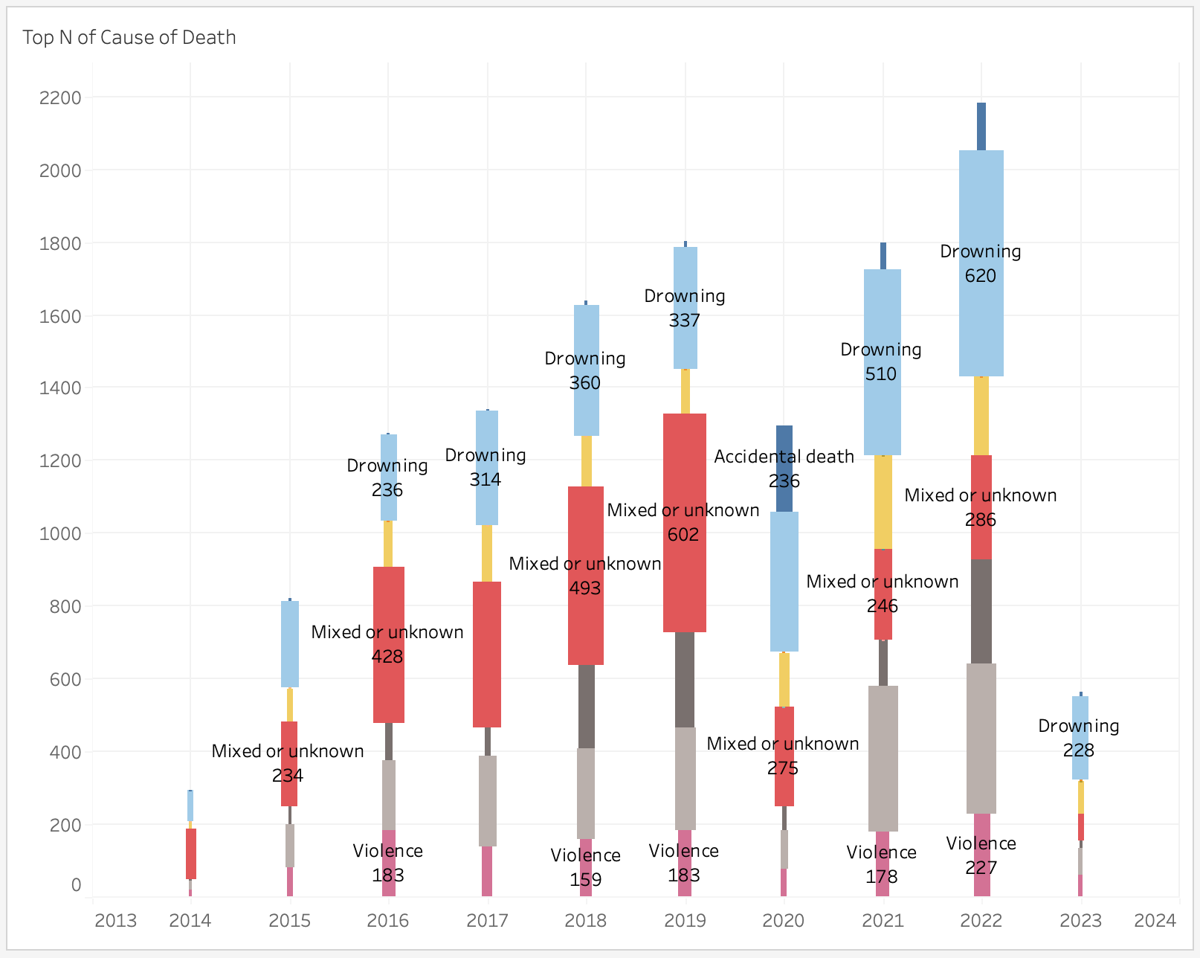
Cause of Death
From 2014 to now, under the limitation of parameter “Top N of Cause of Death,” we found that two of the most frequent cause of death is Mixed or unknown and Drowning. As we can see from the picture, the size of the bar is determined by the number of causes of death. From 2014 to 2018, Mixed or unknown kept the position of the most cause. From 2018 to now, drowning has become the most common one.

Slide 22
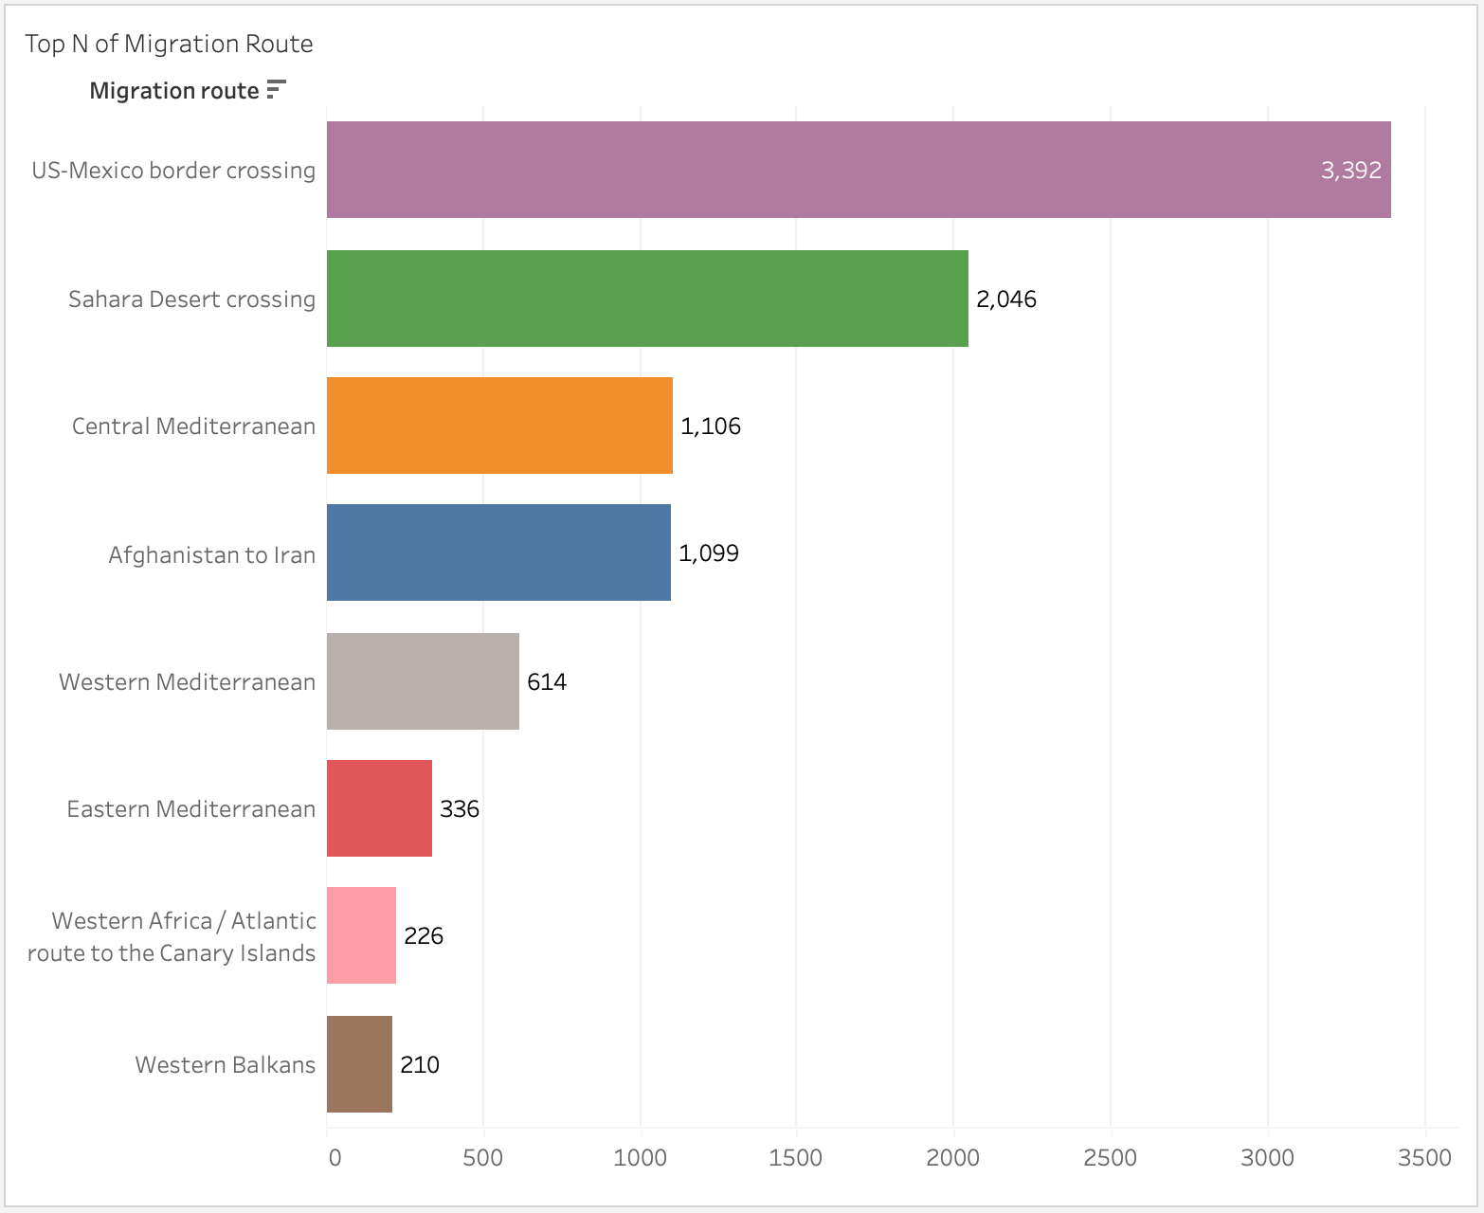
Migration Route
Under the limitation of the parameter “Top N of Migration Route” we found some routes that occurred incidents most frequently. US-Mexico border crossing is the most frequent one; the number of this route is 3,392, which is more than other routes. The second is the Sahara Desert crossing, of which the number is 2,064. The Central Mediterranean route is the third, of which the number is 1,106. The fourth is the Afghanistan to Iran route, with the number of 1,099.

Slide 23
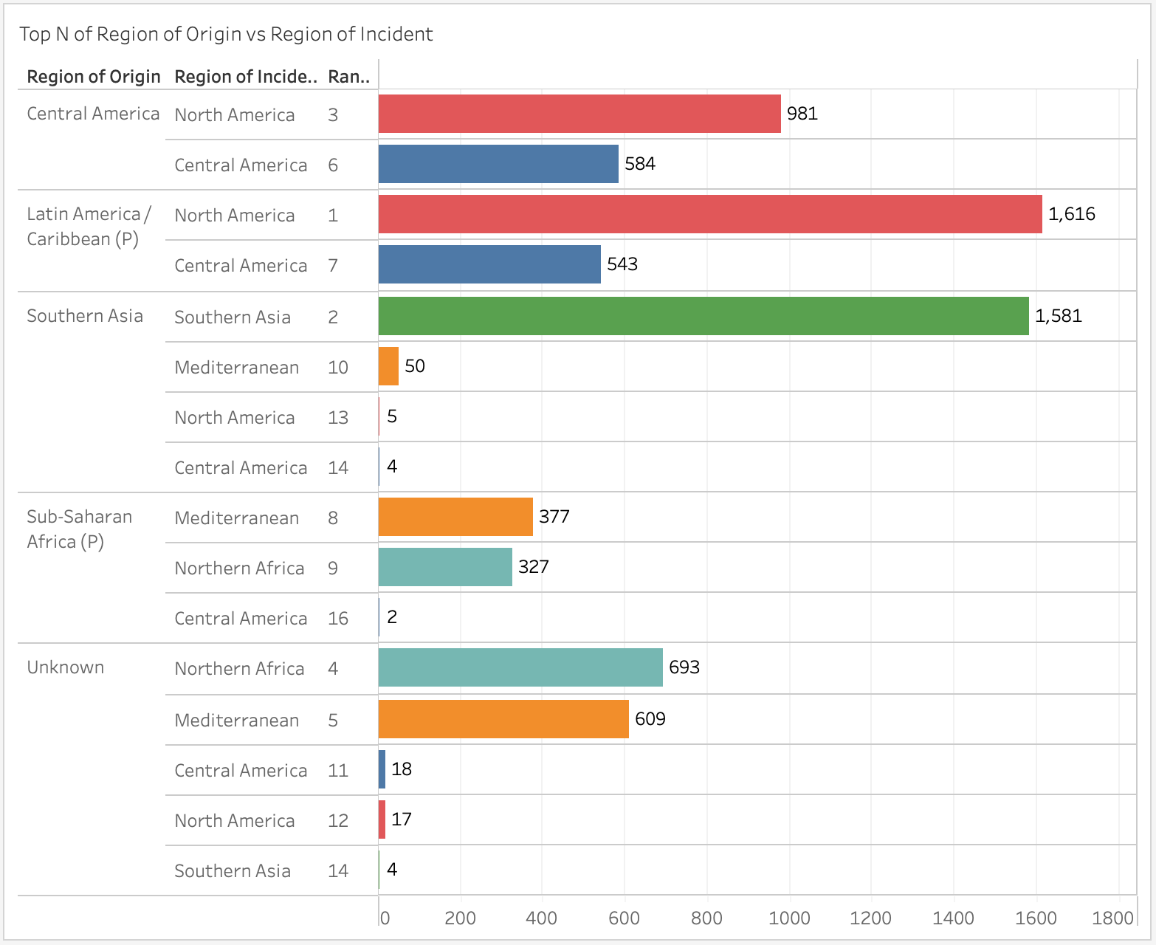
Region of Origin vs Region of Incident
Under the limitation of the parameters “Top N of Number of Region of Origin” and "Top N of Number of Region of Incident," we found the most frequent origin region is Central America, which has the two most frequent incidents regions are North America and Central America. The second frequent origin region is Latin America, and the condition of incident regions is the same as the above. The number in Central America is 1,616, which is located at the position of rank one of the number of regions of incidents. The next frequent origin region is Southern Asia, which has the matched incidents region of Southern Asia with a number of 1,581.

Slide 24
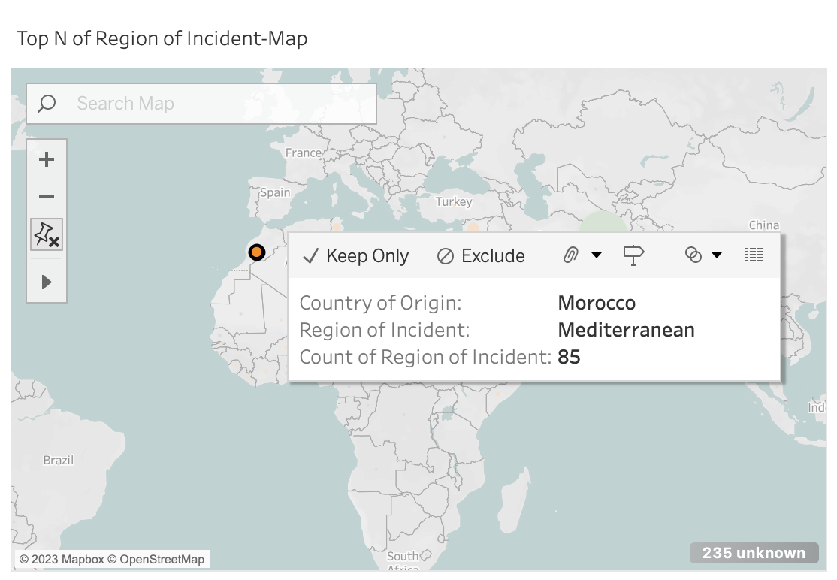
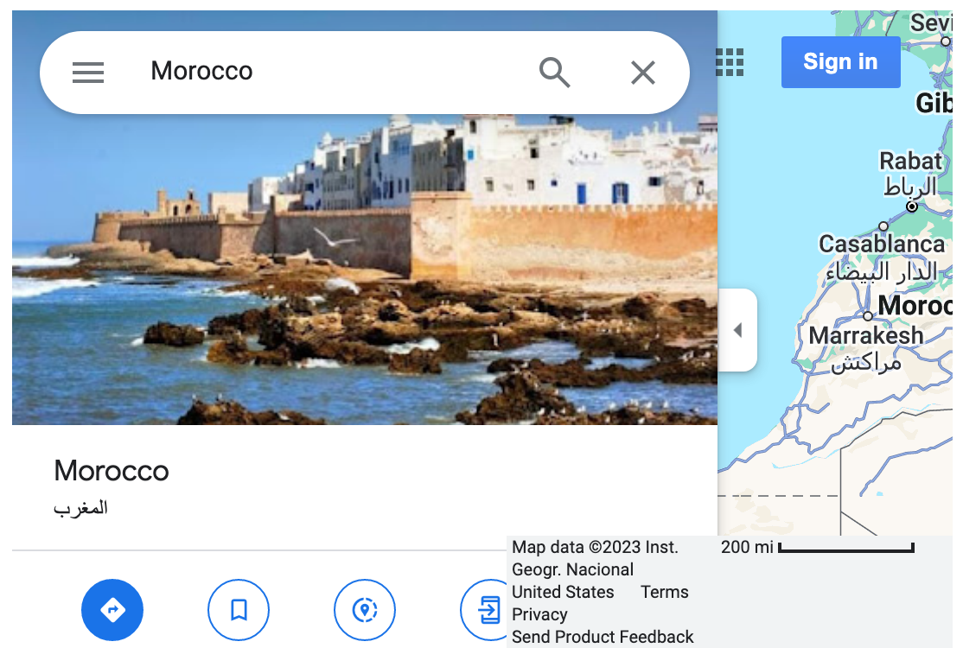
Map Analysis - Region of Incident
The map shows the parameters "Top N of Number of Region of Incident," the size of the circle is determined by the number of incidents in different regions. As clicking one of the circles on the map, the webpage area will show its Google Map profile.

Slide 25
Story Interpretation

Slide 26
Story Interpretation
The Story contains four Datashboard (Two of them are quite same. The first Dashboard 1 does not have worksheet filtering and the second Dashboard 1 can filter different charts based on filters).
The first dashboard (Two of the Dashboard 1) mainly based on the year.
The second dashboard mainly base mainly based on the number of people (Women, Men and Children), and evidences (Dead and Survivors)
The last dashboard mianly based on the migration route.

Slide 27
Recommendations

Slide 28
Recommendations
According to our research, we found that there are three routes that have a higher possibility of causing death.
They are the US-Mexico border crossing, the Sahara Desert crossing, and the Central Mediterranean.
What’s more, the most frequent reason for death is drowning.
Therefore, we suggest that scholars should pay more attention to these routes and their regions and the drowning to conduct research.

